Slide 1

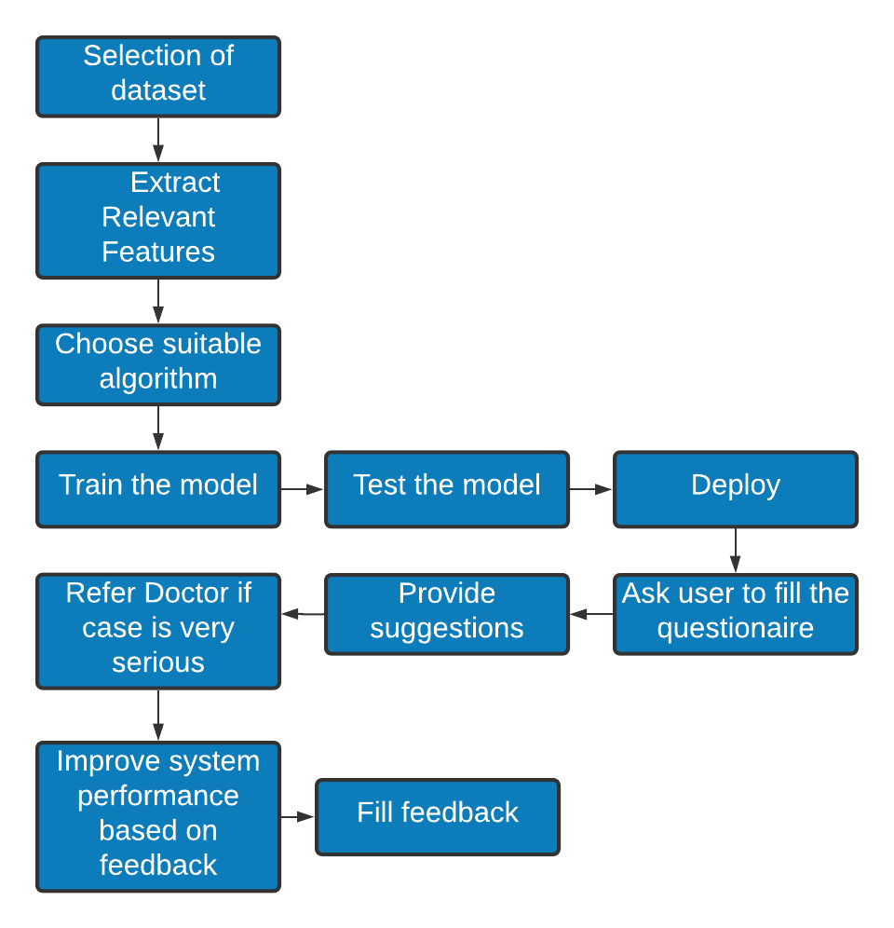
Title of the Project : COVID COMPANION
St.Francis Institute of Technology , Department of Computer Engineering
Prakalp Competition
Group no: 09
Group Members: 02 Rishika Ahuja, 07 Ann Zachariah, 37 Aishwarya John, 44 Anashwara Kurien
Abstract
Proposed Methodology
Work done so far
The COVID-19 outbreak, declared as a pandemic by the World Health Organization (WHO), has rapidly spread across the globe spreading havoc in its wake. Having suddenly distorted each and every person's routine lifestyle, this pandemic has put our mental health at risk since it has been proven stressful for plenty of people. Thus there has been an exponential increase in the number of people suffering from mental disorders with the onset of this pandemic. In this project we have tried to quantify the effect of COVID-19 on the mental health of the users of our system and then suggest to them some basic ways to help them cope with it. The System is built for the general population as the sudden pandemic has affected everyone objectively. To Achieve this, a model is prepared based on the dataset which contains the mental health information of people during the pandemic. After the dataset is cleaned and processed, Feature Selection is performed with the help of the PCA algorithm. The user's features are collected with the help of a questionnaire and given to the trained model. Neural networks will be used to train and help the model learn. Thus the mental health of the user is analyzed and suggestions are given which help to improve the mental health of the user.
Module No. | Completion status
1 | Dataset Selection | Dataset was taken from COVIDiSTRESS Global Survey
2 | Data Exploration, Cleaning | The Dataset was found to have 125306 rows. The Null Values were removed
3 | Model training | For Feature Selection -PCA For Model Training- NN
4 | Front end modules | Quote generator, MRS, feedback, questionnaire
Conclusion and future directions
This project is aimed at tackling the sudden downgrading mental health of the general population that is brought about by the onset of the global pandemic. It has a huge societal impact and is the need of the hour. Our Project aims to provide tailored suggestions to the entire general population based on the COVID Anxiety Scale hence making it more accurate for the Users. This approach provides complete client anonymity and widespread service to anyone from anywhere. In the future we could develop this application and widen the scope of this project for various other diseases like cancer, cardiovascular problems, etc. We could add into this a module which provides a platform for online consultations with psychiatrist and other physicians.
Problem Statement
Figure 1: Workflow
To create a companion system for an individual which helps to analyze the mental health of the being during Covid-19 pandemic and provides precise suggestions based on their mental condition. In cases where the users are found to have critical levels of anxiety and depression requiring professional help, the user will be given exclusive reference to a professional Psychiatric.
Algorithms used
For Feature Selection PCA ( Principal Component Analysis) was used to train and to help the model learn Neural Networks are used .
Experimental Setup
References
Literature Survey
Operating System: Windows 10 and higher
Application : Visual Studio Code, Colab Notebook
Programming Language : Python & Anvil
Dataset: COVIDiSTRESS Global Survey Dataset (125306 rows)
[1] Yenan Wang, Yu Di, Junjie Ye & Wenbin Wei,” Study on the public psychological states and its related factors during the outbreak of coronavirus disease 2019 (COVID-19) in some regions of China, Psychology, Health & Medicine”, 2020
[2] Yamada, Y., Ćepulić, DB., Coll-Martín, T. et al.,” COVIDiSTRESS Global Survey dataset on psychological and behavioural consequences of the COVID-19 outbreak.”, 2021
[3] Sherman A. Lee, ” Coronavirus Anxiety Scale: A brief mental health screener for COVID-19 related anxiety, Death Studies”, 2020
Paper 1:The algorithm used in this paper is logistic regression. Scale:SAS SDS
Paper 2:This dataset probes into the psychiatric issues that migrant workers face and trauma that they underwent during the pandemic using Coronavirus Anxiety Scale (CAS).
Paper 3: For each of the predicted variables (i.e., fear and health), they fit two types of machine learning models, one being a linear model (LASSO) and one being a non-linear model (ERT]).
Performance Parameters
For the performance evaluation of the project we have used Mean squared error loss and have got an accuracy of 69.8% so far.

